Slide 1

Bird Strikes Data Analysis

Slide 2
INTRODUCTION
A bird strike, defined as a collision between a bird and an aircraft engine, can cause serious mishaps such as crash landings or aircraft stalling. To prevent future incidents, we propose predicting bird strikes and analyzing historical data. This involves examining parameters like phase of flight, time of day, altitude, bird species, and size to establish patterns. Understanding these patterns can help predict and prevent bird strikes, ultimately saving lives. Algorithms such as linear regression, random forest, and time series analysis will be used for prediction.

Slide 3
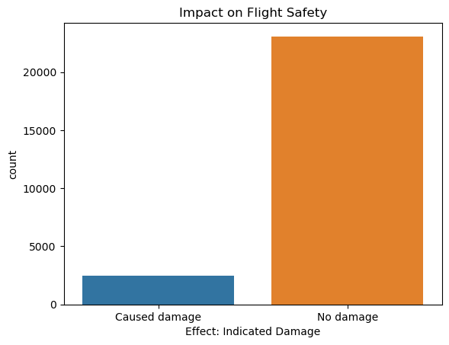
Impact Analysis
Most bird strikes do not cause damage, but those that do can incur significant costs, especially during the climb, approach, and take-off run phases of flight.

Slide 4
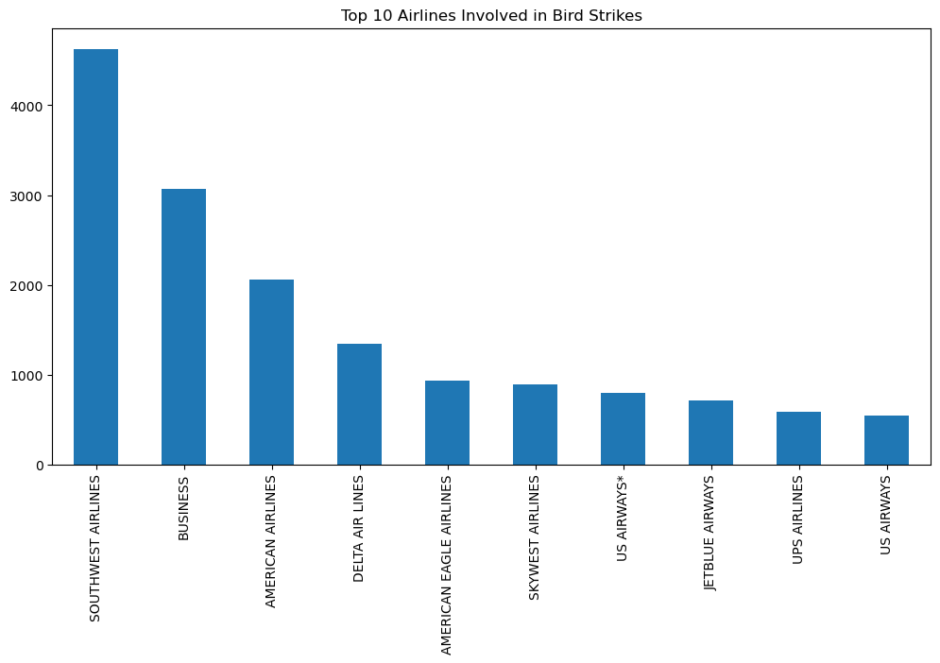
Airline/Operator Analysis: Examine which airlines are most frequently involved in bird strikes and their associated costs.

Slide 5
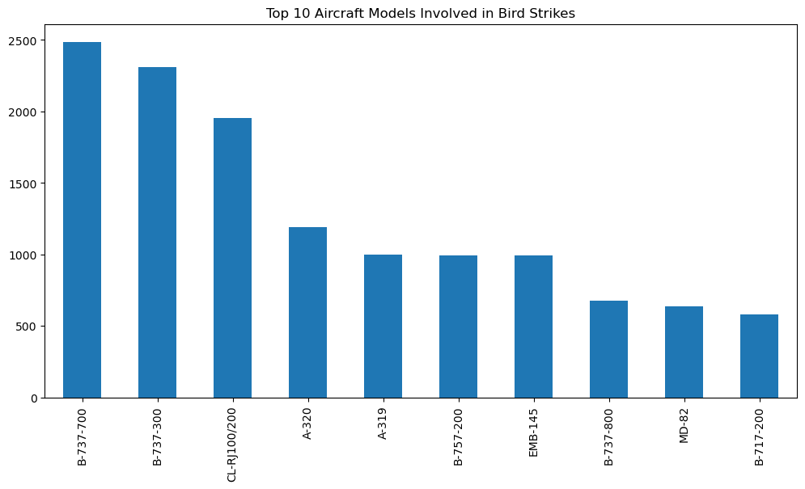
Aircraft Models: Analyze the distribution and costs associated with different aircraft models.

Slide 6
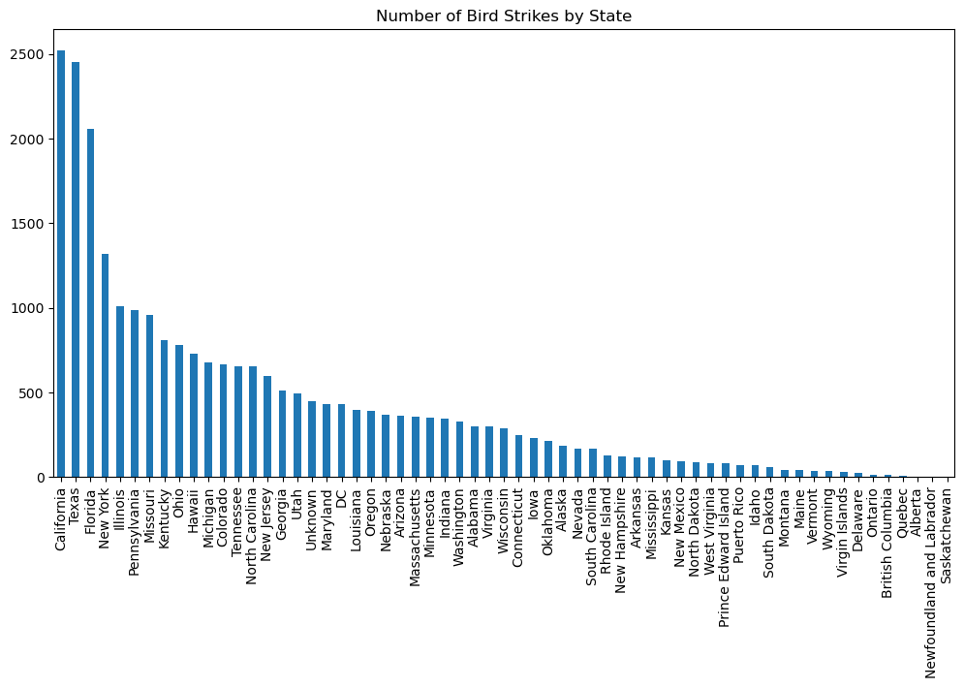
Geographical Analysis

Slide 7
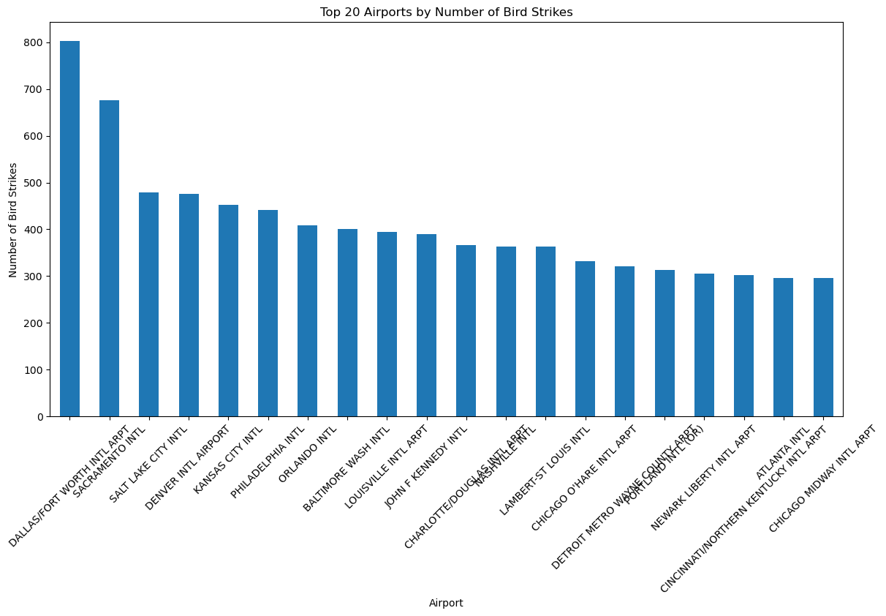
Frequency of Bird Strikes by Airport

Slide 8
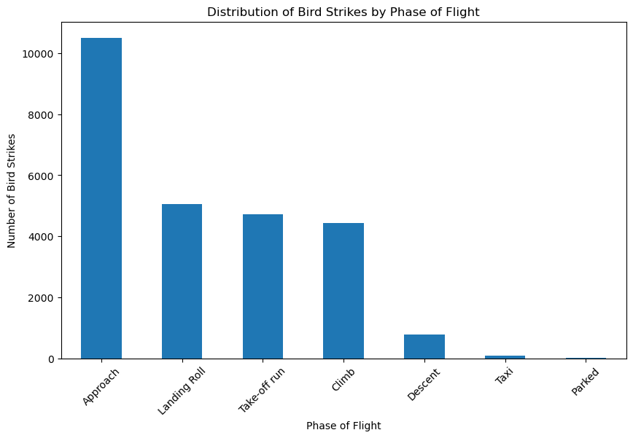
What are the common phases of flight during which bird strikes occur?
Distribution of Bird Strikes by Phase of Flight

Slide 9
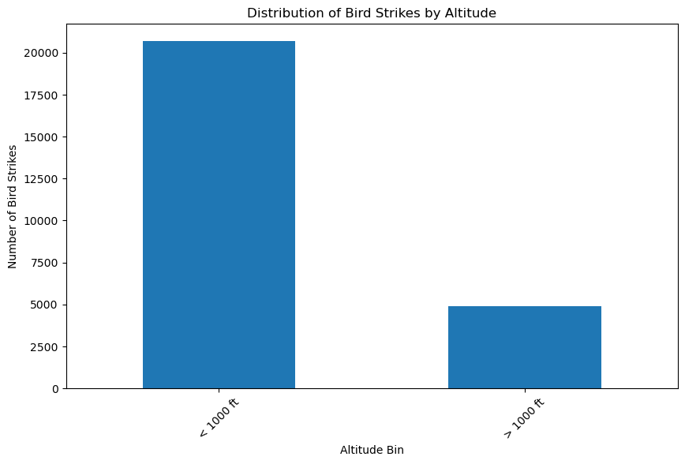
How does the altitude of flight influence the likelihood and impact of bird strikes?
Impact of Altitude on Bird Strikes

Slide 10
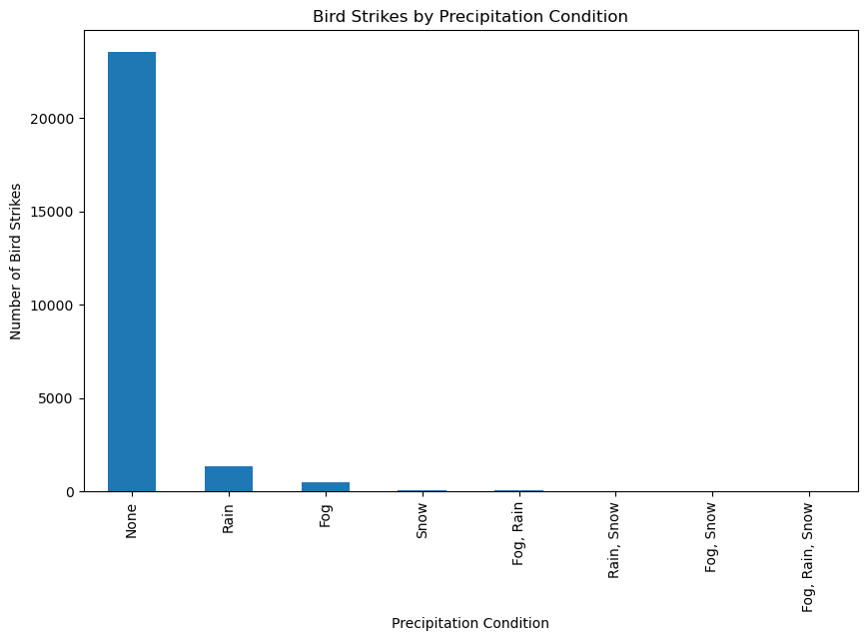
What are the environmental conditions (precipitation, sky conditions) associated with higher bird strike incidents?
Environmental Conditions and Bird Strikes

Slide 11
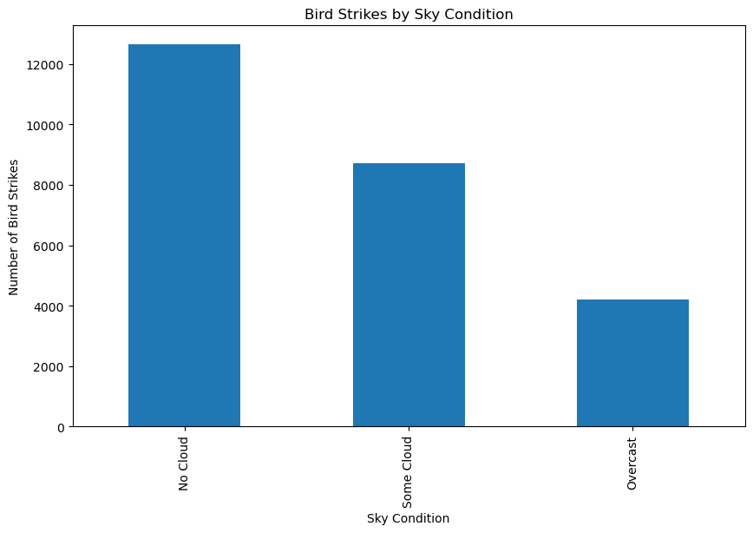

Slide 12
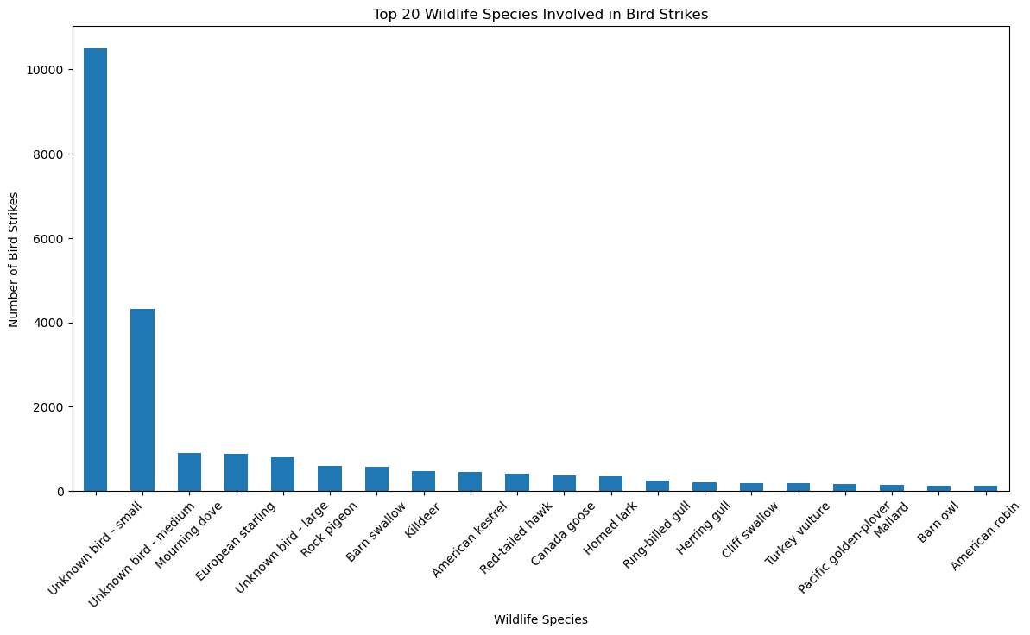
Are there specific bird species that pose a higher risk, and are these species more active during certain periods?
Species Analysis

Slide 13
Conclusion
The analysis of bird strike data reveals critical insights that can significantly improve aviation safety and operational efficiency. Key findings indicate that bird strikes are most frequent during the approach, landing roll, take-off run, and climb phases of flight. By focusing on these high-risk phases and understanding the environmental conditions and bird species behavior, airlines and airports can implement targeted strategies to mitigate bird strikes.

Slide 14
Future Steps
Enhanced Detection and Monitoring:
Install advanced radar and surveillance systems to monitor bird activity.
Integrate bird activity data with air traffic control for real-time warnings.
Bird Deterrent Technologies:
Use acoustic and visual deterrents to keep birds away from airports.
Pilot Training and Awareness:
Conduct regular training on bird strike risks and response strategies.
Include bird strike scenarios in flight simulators.
Habitat Management:
Modify airport surroundings to be less attractive to birds.
Collaborate with wildlife experts for effective bird management.

Slide 15
5.Operational Adjustments:
Adjust flight schedules to avoid peak bird activity times.
Modify flight paths to steer clear of high bird activity areas.
6.Public and Community Engagement:
Educate the public about not feeding birds near airports.
Develop community programs to manage bird populations.
7.Predictive Analytics and Proactive Measures:
Use predictive analytics to forecast high-risk periods for bird strikes.
Implement proactive bird management during high-risk times.
By following these steps, airlines and airports can reduce bird strike incidents and enhance flight safety.

